Slide 1
Agora Trading E-commerce Portal
Content
Wire Frame
Behat Features
Entity Relationship Diagram
Database Creation & Queries
Mock HTML / Forms
Class Diagram

Slide 2
Wire Frame Forms

Slide 3
Sign in
<<header>>
Logo
Sign up
Agora Trading
News
Listings
Activity
<<nav>>
<<main>>
<<form>>
Username
<<Input>>
Password
<<Input>>
Forgot password?
Sign in
Sign up…
<<li>> or <<p>>
(Footer content)
<<footer>>

Slide 4
Header and footer same as sign in page**
<<form>>
Acc type
<<dropdown>>
First name
<<Input>>
Sign up page… once account type drop down option is chosen it will unhide either Business seller or buyer form. This is what Seller / buyer form will look like
Last name
<<Input>>
Address
<<Input>>
<<main>>
City
<<Input>>
Email
<<Input>>
Password
<<Input>>
Confirm pass
<<Input>>
Submit
Already have an account… Sign in

Slide 5
Header and footer same as sign in page**
<<dropdown>>
<<form>>
Acc type
<<main>>
Business name
<<Input>>
Sign up page… once Account type drop down option is chosen it will unhide either Business seller or buyer form. This is what Business form will look like
Registration #
<<Input>>
?
Link to info about NZ business registration
Logo
<<choose file>>
Bank #
<<Input>>
HQ Address
<<Input>>
HQ City
<<Input>>
Email
<<Input>>
Password
<<Input>>
Confirm pass
<<Input>>
Submit
Already have an account… Sign in

Slide 6
add new or edit listing
<<header>>
Logo
Log out
Agora Trading
News
Listings
Activity
<<nav>>
<<main>>
name
<<input>>
description
<<input>>
Price
<<input>>
In stock
<<input>>
photo
<<Choose file>>
Category <<dropdown>>
Submit
<<li>> or <<p>>
(Footer content)
<<footer>>

Slide 7
Wire frame Template

Slide 8
home page
<<header>>
Logo
Sign In
Sign Up
Agora Trading
Home
Listings
Activity
<<nav>>
Reasons you should make an account with agora trading
<<main>>
<<section>>
<<section>>
Some more info about why you should sign up
Get Started
Will link to sign up page
<<li>> or <<p>>
(Footer content)
<<footer>>

Slide 9
All listing page
<<header>>
Logo
Log out
Agora Trading
News
Listings
Activity
<<nav>>
New Listing
<<main>>
<<section>>
Search <<input>>
sort <<dropdown>>
<<section>>
Business logo
Item name
Price
Listing ‘cards’ are clickable (link to single listing page)
<<Scrollable box>>
In stock
Profile information
Listed date
Item name
Price
Listing ‘cards’ are clickable (link to single listing page)
In stock
Listed date
Edit
Will link to sign up page
<<li>> or <<p>>
(Footer content)
<<footer>>

Slide 10
single listing page
<<header>>
Logo
Log out
Agora Trading
News
Listings
Activity
<<nav>>
Business logo
<<main>>
<<section>>
<<section>>
Business logo
Item Name
Price
Profile information
In Stock
Category
Description
Edit
Will link to edit profile page
Edit
Delete
<<li>> or <<p>>
<<footer>>
(Footer content)

Slide 11
Activity page (not implementing)
<<header>>
Logo
Log out
Agora Trading
News
Listings
Activity
<<nav>>
Recently sold /bought
<<main>>
<<section>>
<<Scrollable box>>
<<section>>
Business logo
Date
Item name
Price
Quantity
Buyer /seller Business
Date
Item name
Price
Quantity
Buyer Business
Profile information
Date
Item name
Price
Quantity
Buyer Business
Date
Item name
Price
Quantity
Buyer Business
Date
Item name
Price
Quantity
Buyer Business
Will link to sign up page
Edit
<<li>> or <<p>>
(Footer content)
<<footer>>

Slide 12


Cart / Checkout page (not implementing)
<<header>>
Logo
Log out
Agora Trading
News
Listings
Activity
<<nav>>
Purchased Items
<<main>>
<<section>>
<<section>>
Business logo
Item name
Price
Quantity
Seller Business
Item name
Price
Quantity
Seller Business
<<Scrollable box>>
Profile information
Item name
Price
Quantity
Seller Business
Item name
Price
Quantity
Seller Business
Sends invoice to business
Confirm
Total
Edit
Will link to edit profile page
<<li>> or <<p>>
(Footer content)
<<footer>>

Slide 13
Business users page (not implementing)
<<header>>
Logo
Log out
Agora Trading
News
Listings
Activity
<<nav>>
Users
username<<input>>
Invite User
<<main>>
Activity will link to the buyers/sellers activity page..
Buyer / Seller
profile
Buyer / Seller
profile
Buyer / Seller
profile
Full name
Activity
Full name
Activity
Full name
Activity
profile will link to the buyers/sellers profile page.. (without the edits displaying)
City
Delete
City
Delete
City
Delete
Buyer / Seller
profile
Buyer / Seller
profile
Buyer / Seller
profile
Full name
Activity
Full name
Activity
Full name
Activity
City
Delete
City
Delete
City
Delete
<<li>> or <<p>>
(Footer content)
<<footer>>

Slide 14
Behat Features

Slide 15
User – Buyer Feature: As a buyer I should be able to Search listings
Scenario – I search for ‘apples’ on listing page
Given I have a buyer account
And there is listings for ‘apples’
When I type ‘apples’ in the search input
And click search button
Then all the listings with ‘apples’ in the category name or description should be displayed
Scenario – I search for ‘cauliflower’ on listing page
Given I have a buyer account
But there is no listing for ‘cauliflower’
When I type ‘cauliflower’ in the search input
And click search button
Then there will be no listings shown
And a message will promp stating ‘No Results Found’

Slide 16
User – Seller Feature: As a seller I should be able to add listings to my account to sell
Scenario – I add a listing with all the required information
Given I have a seller account
When I input the item name, description, photo, price and quantity in stock
Then the item should be added to my account
Scenario – I add a listing but do not input product price
Given I have a seller account
When I input the item name, description, photo and quantity in stock
Then an error message will be displayed stating required field “Price” needs to be input.

Slide 17
User – Business Admin Feature: As a Business Admin I should be able to view listings for all my sellers accounts
Scenario – I have 3 highly active sellers that create listings regularly
Given I have a business admin account
When I click on listings link
Then I can view all the listings my sellers have made
And I can filter between sellers.
Scenario – I have no sellers linked to my business account
Given I have a business admin account
When I click on listings link
Then the page is blank because i have no sellers
And no listings
And the seller is already linked to another business account
Then an alert will prompt me that the seller is already linked to a business
And to try a different username

Slide 18
Entity Relationship Diagram

Slide 19
Design using Visio

Slide 20
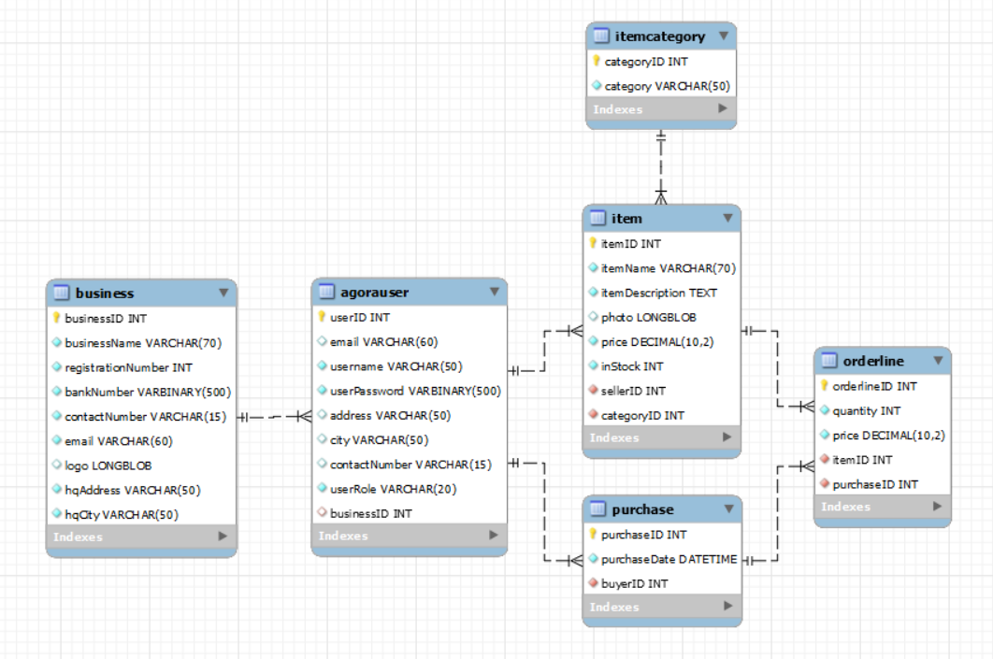
Reverse engineered ERD

Slide 21
Database Creation and Queries

Slide 22
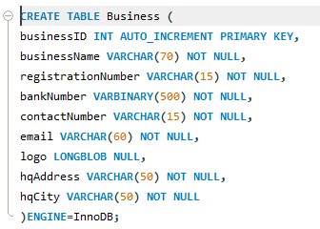
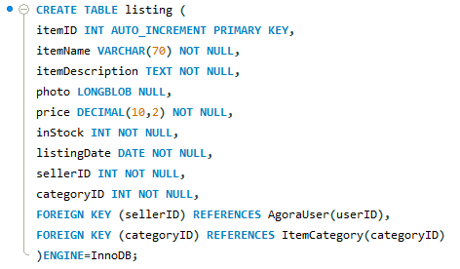
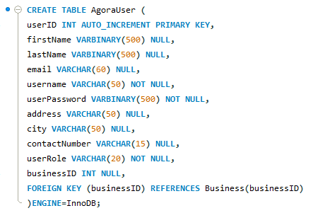
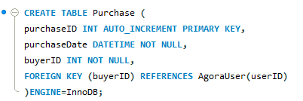
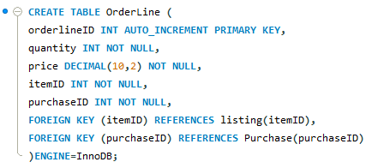


Slide 23
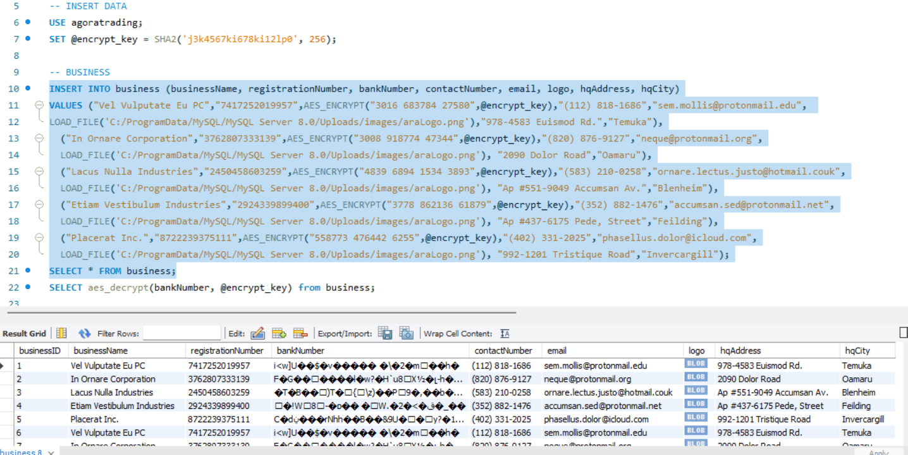

Slide 24
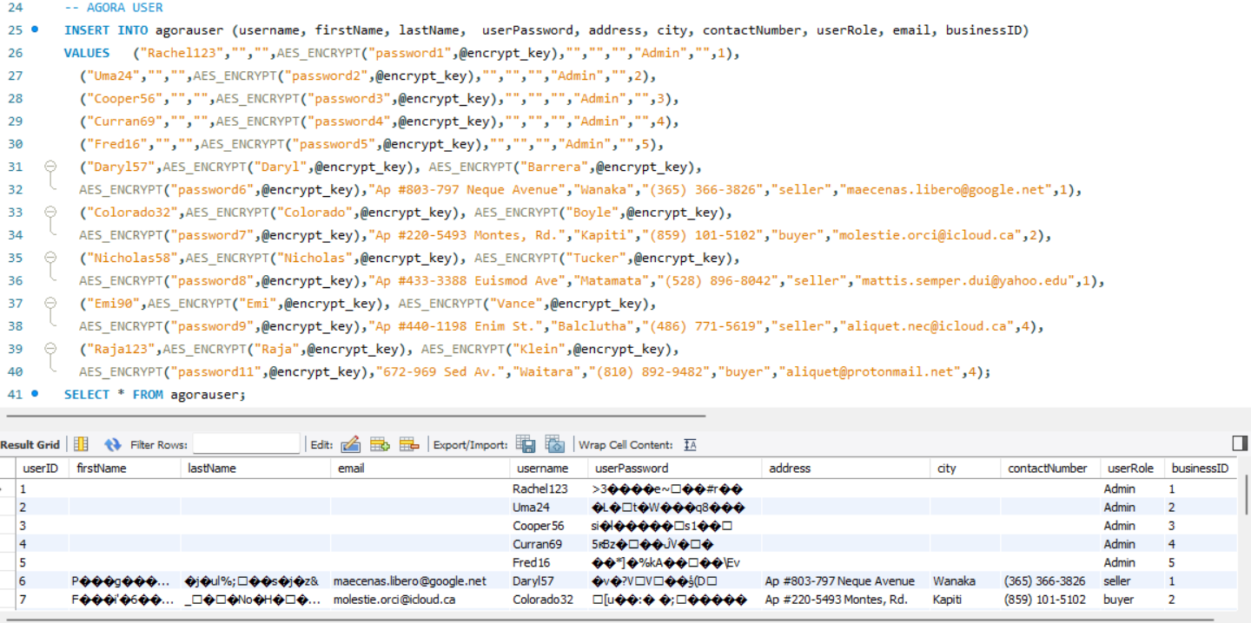

Slide 25
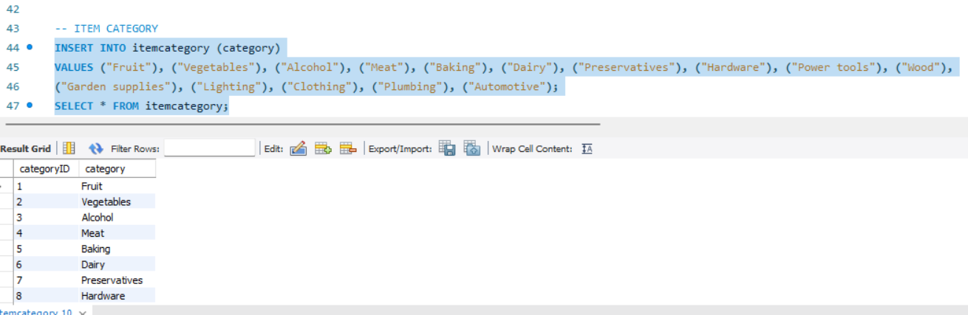

Slide 26
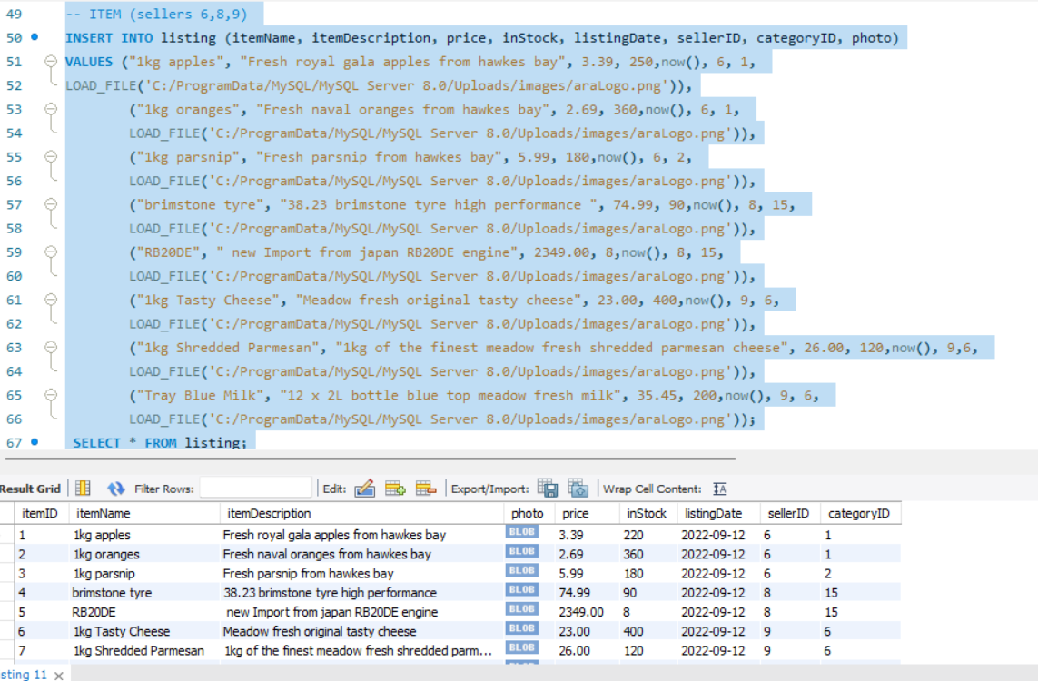

Slide 27
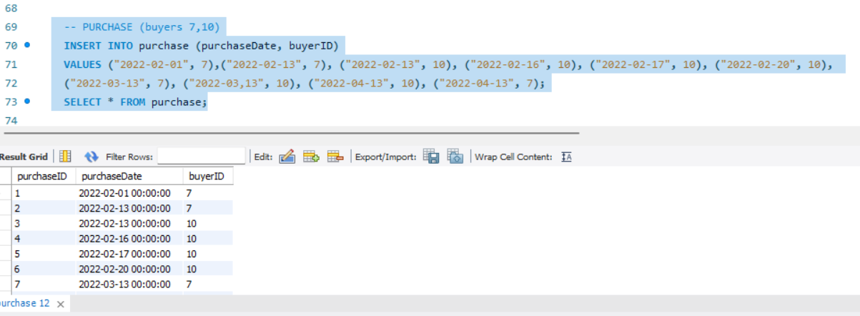

Slide 28
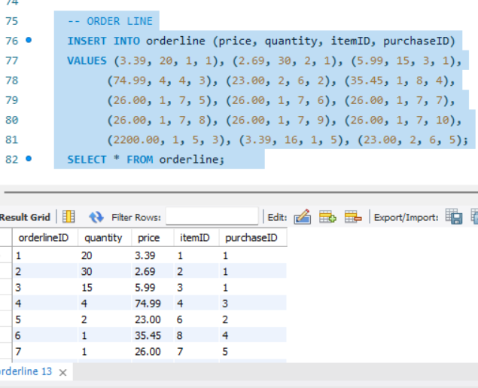

Slide 29
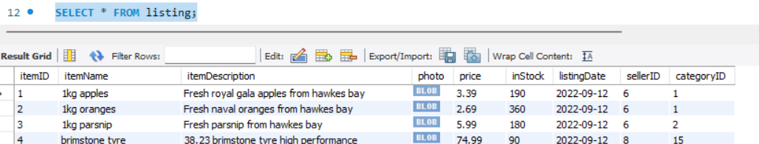
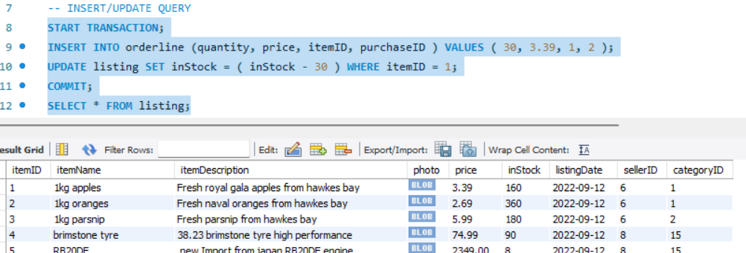


QUERIES – Insert / update query

Slide 30
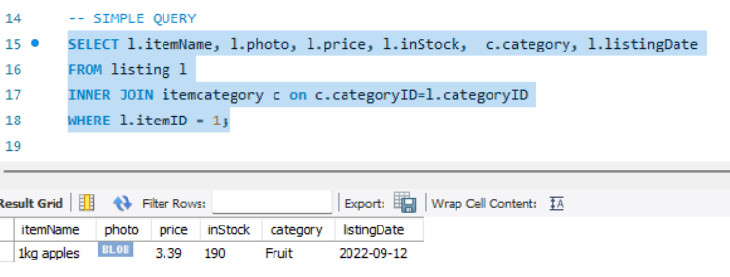
QUERIES – Simple Query

Slide 31
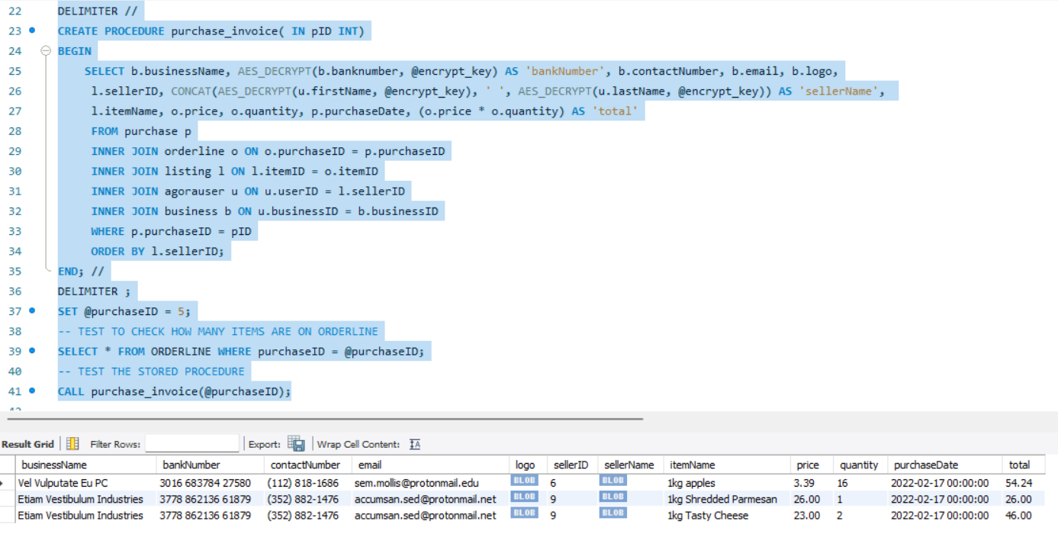
QUERIES – Complex Query

Slide 32
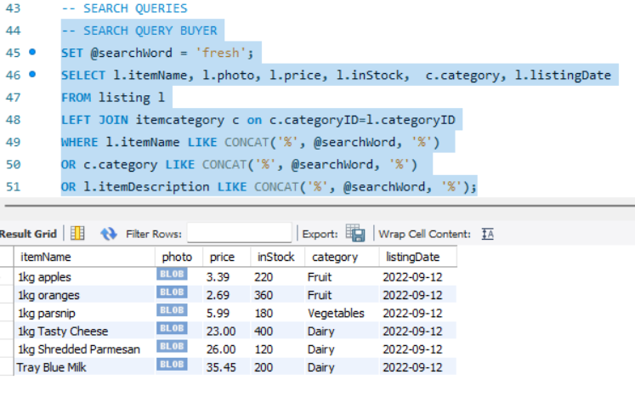
QUERIES – Search Query (Buyer)

Slide 33
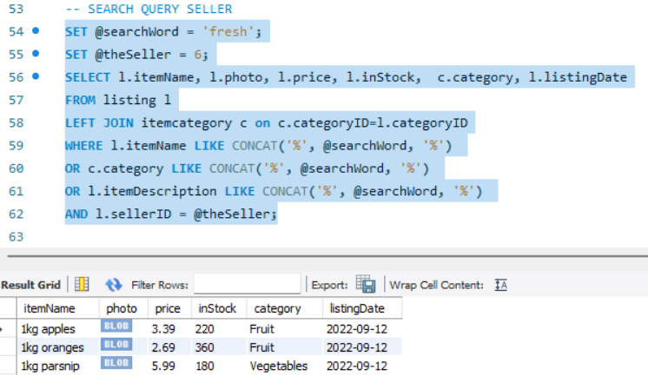
QUERIES – Search Query (Seller)

Slide 34
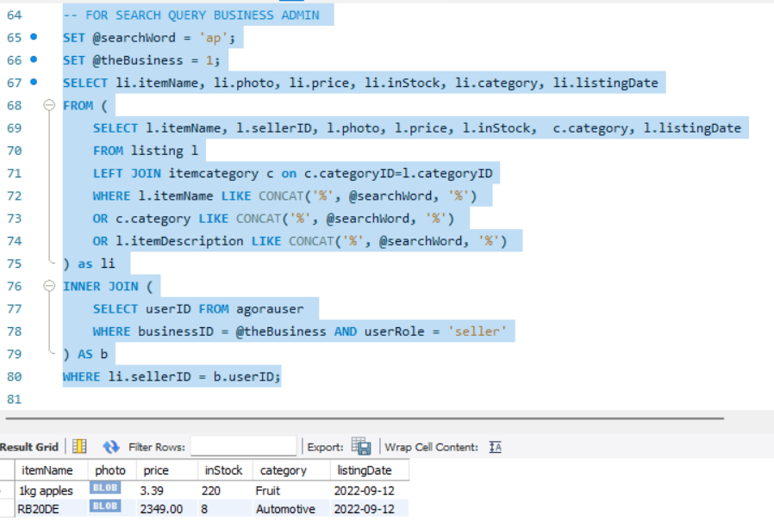
QUERIES – Search Query (Business Admin)

Slide 35
Mock HTML / Forms

Slide 36
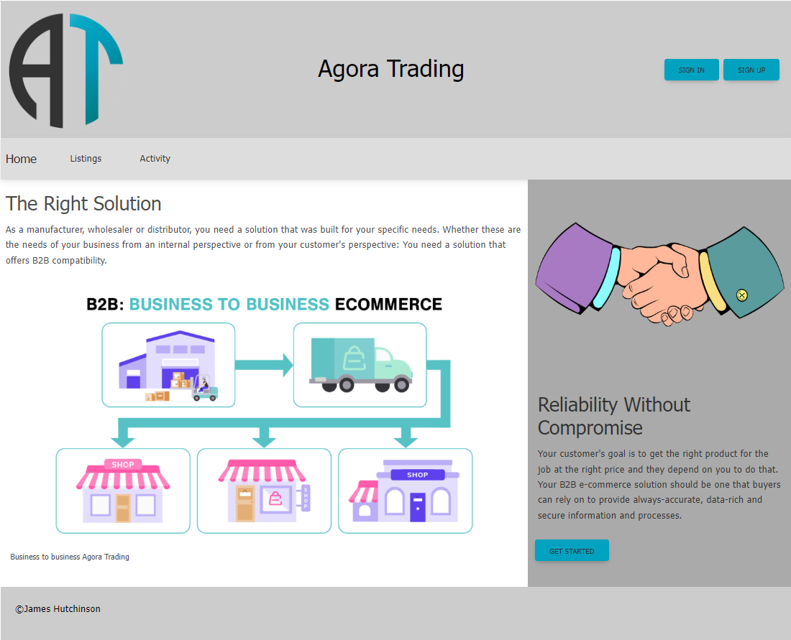
index.html
(HOME PAGE)

Slide 37
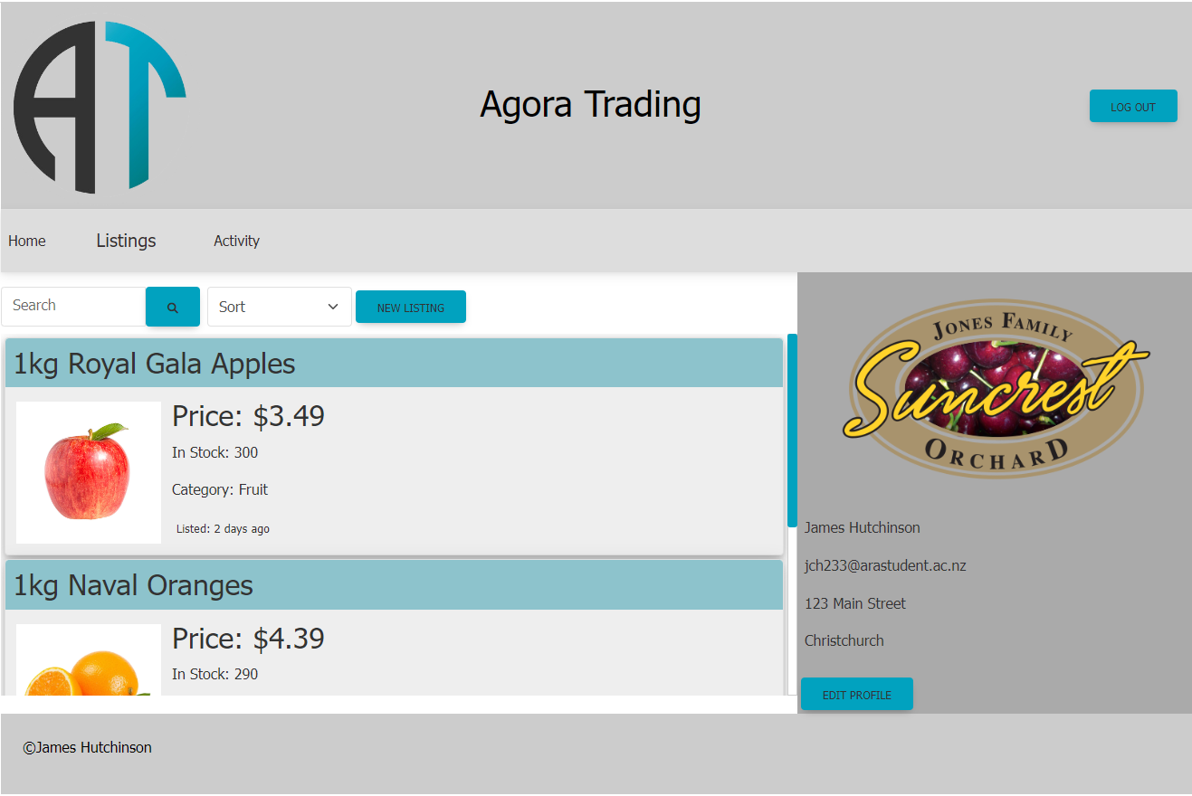
allListings.html
(All listings - seller view)

Slide 38
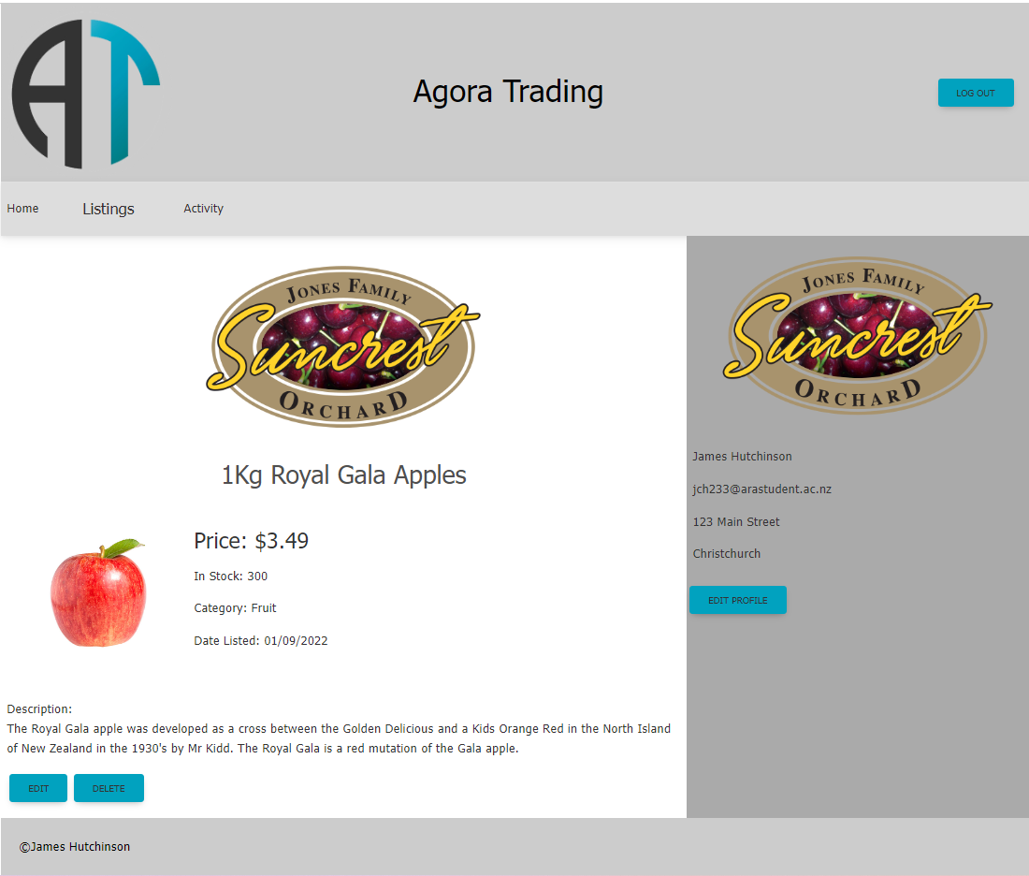
listing.html
(single listing - seller view)

Slide 39
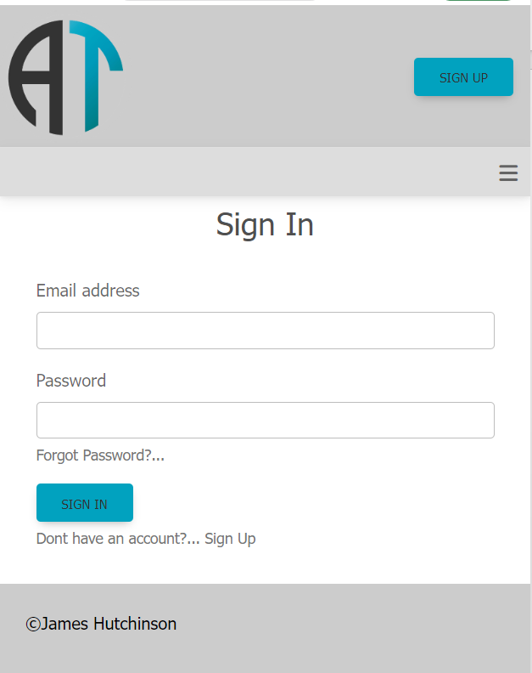
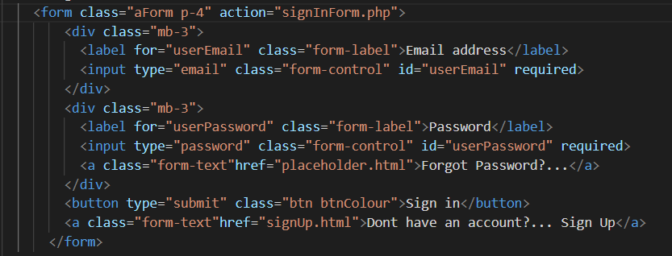
Sign in form

Slide 40
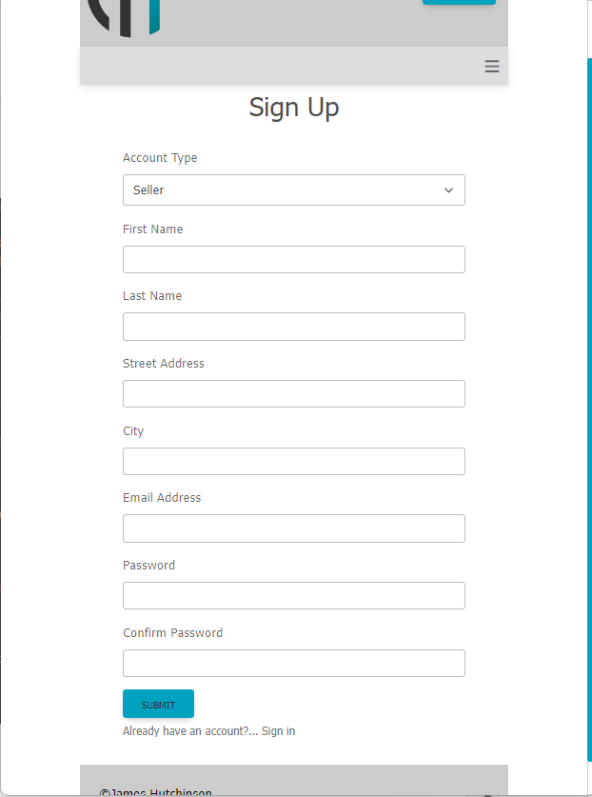
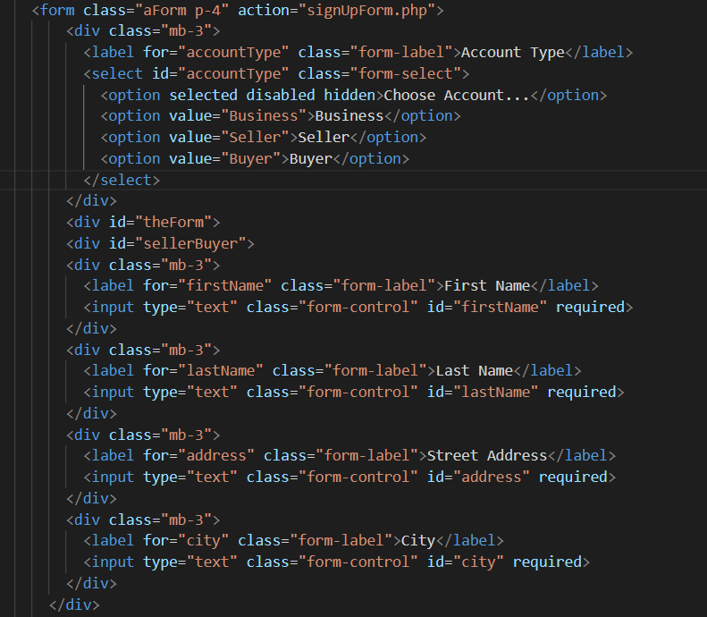
Buyer / Seller sign up form

Slide 41
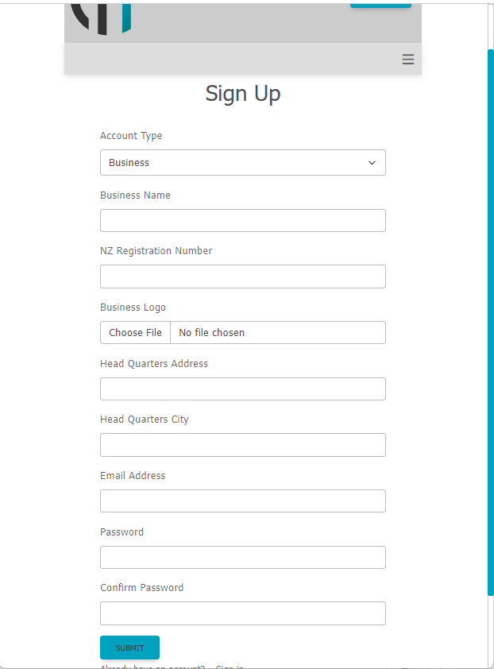
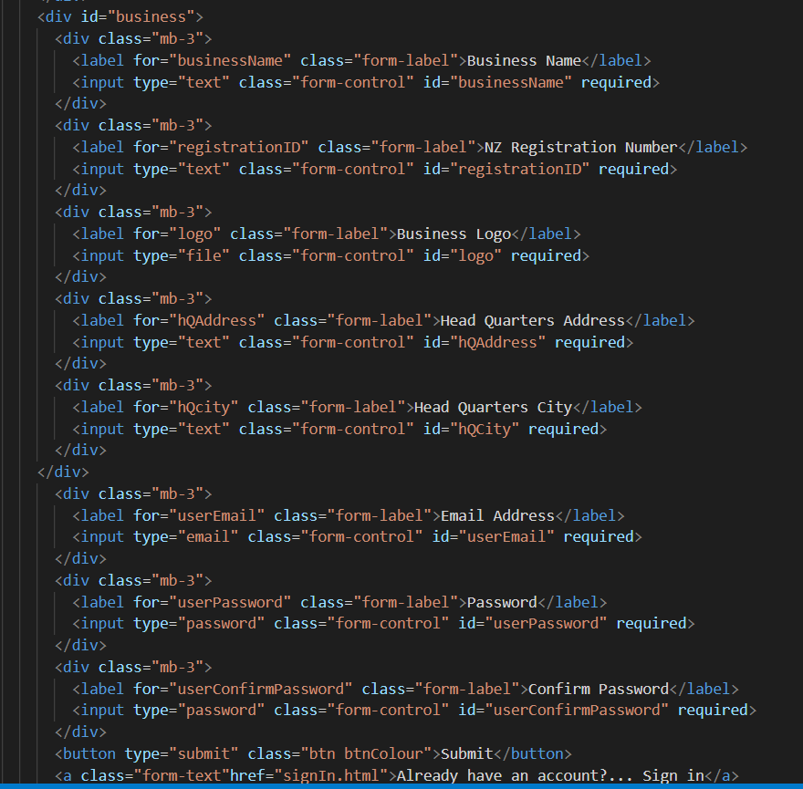
Business admin sign up form

Slide 42
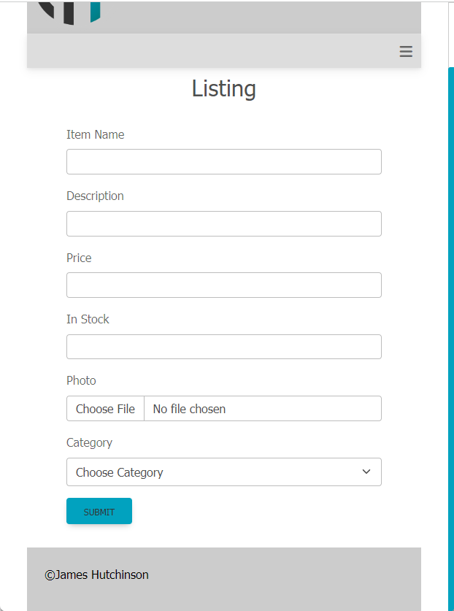
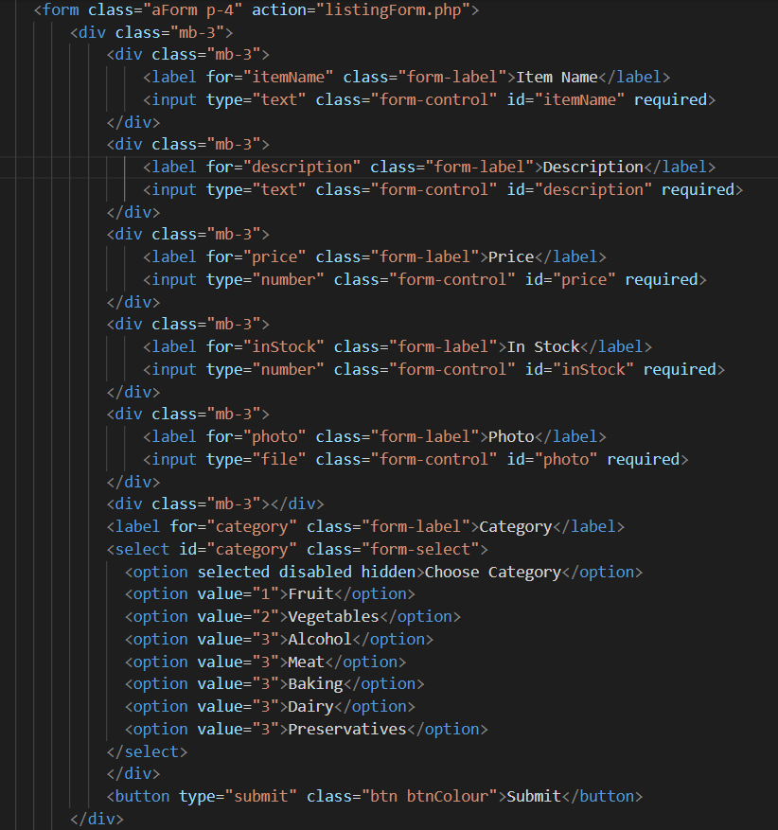
New / Edit listing form

